Slide 1
LEAD Dataset: How Can Labels for Sound Event Detection Vary Depending on Annotators?
APSIPA ASC 2024
Naoki Koga*, Yoshiaki Bando$†$, Keisuke Imoto*
$∗$Doshisha University, $†$National Institute of Advanced Industrial Science and Technology (AIST)
Dec. 5, 2024
Notes:
Thank you for your introduction. Hello everyone, I’m Naoki Koga from Doshisha University. Today I will talk about the LEAD dataset, which allows us to analyze how strong labels vary among annotators.

Slide 2
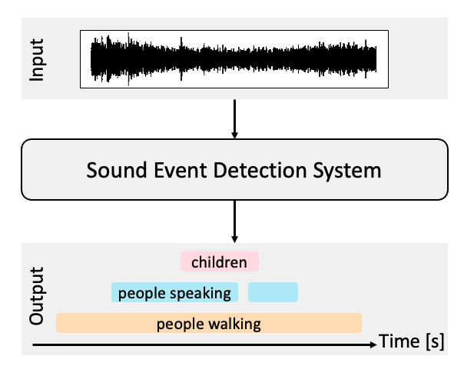
Background: Sound event detection (SED)
Task of estimating the types, onsets, and offsets of sound events[1, 2]
e.g., “children,” “people walking”
[1] A. Mesaros, et al., “Sound event detection in the DCASE 2017 challenge,” IEEE/ACM Transactions on Audio, Speech, and Language Processing, vol. 27, no. 6, pp. 992–1006, 2019.
[2] A. Mesaros, et al., “Sound event detection: A tutorial,” IEEE Signal Processing Magazine, vol. 38, no. 5, pp. 67–83, 2021.
Notes:
This study is related to sound event detection, SED. SED is the task of estimating the types, onsets, and offsets of sound events. Here, onset is the start, offset is the finish of the sound event.

Slide 3
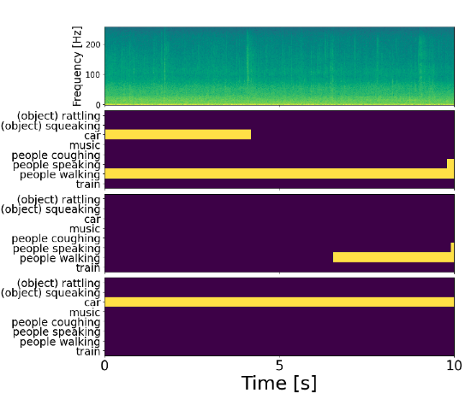
Problem: Annotating strong labels in SED
Variations in the types, onsets, and offsets of sound events
different types, onsets and offsets depending on three annotators
Annotator 1
Annotator 2
Annotator 3
Notes:
SED has one problem: the variations in the types, onsets, and offsets of sound events. SED is known to be difficult to annotate strong labels to sound signals. Here, I illustrate strong labels for one sound signal assigned by three different annotators, who assign strong label for sound signal. As you can see, three strong labels are totally different regarding the types, onsets, and offsets of sound events.

Slide 4
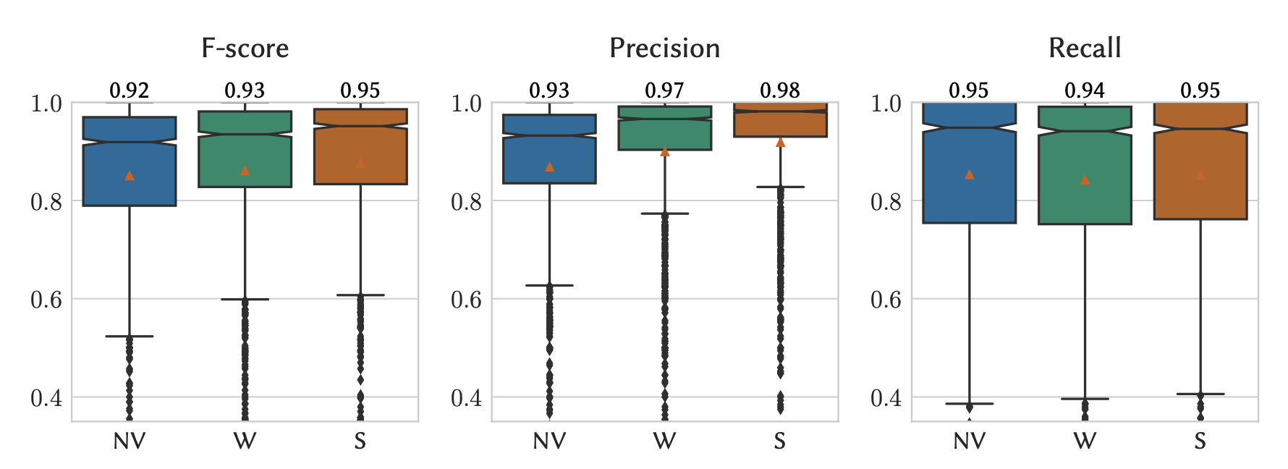
Related work 1: Effects of visualizations on the annotations [1]
Visualization improves the quality of strong labels assigned to sound signals.
NV: no visualization, W: waveform, S: spectrogram
[1] M. Cartwright, et al., “Seeing sound: Investigating the effects of visualizations and complexity on crowdsourced audio annotations,” ACM Transactions on Computer-Human Interaction, vol. 1, no. 29, pp. 1–21, 2017.
Notes:
Some related work were conducted of suppressing the variations in strong labels. One is the analysis for improving the quality of strong labels. Cartwright et al. reported the visualization of the spectrogram especially improved the quality of strong labels.

Slide 5
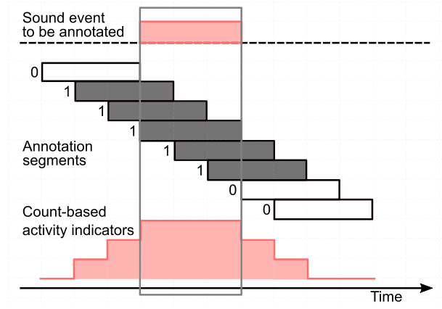
Related work 2: Reliable strong labels in SED [1]
Substitution of the annotation of strong labels with the annotation of multiple weak labels
What are the characteristics of the variations in strong labels?
[1] I. Martín-Morató et al., “Strong labeling of sound events using crowdsourced weak labels and annotator competence estimation,” IEEE/ACM Transactions on Audio, Speech, and Language Processing, vol. 31, pp. 902–914, 2023.
Notes:
The other is about reliable strong labels in SED. Martín-Morató et al. proposed a method to substitute the annotation of strong labels with the annotation of multiple weak labels. Like these examples, most of the related work is about handling the variations in strong labels. But I wonder if we should investigate what are the characteristics of the variations in strong labels themselves.

Slide 6
Overview of our contributions
Building the LEAD dataset
Analyses with the LEAD dataset
Experiment with the LEAD dataset
Notes:
This is the overview of our contributions.
We will talk about building the LEAD dataset, the analyses with the LEAD dataset, and the experiment with the LEAD dataset.

Slide 7
Overview of our contributions
Building the LEAD dataset
Analyses with the LEAD dataset
Experiment with the LEAD dataset
Notes:
The first contribution is building the LEAD dataset, a large-scale annotator’s labels for sound event detection dataset.

Slide 8

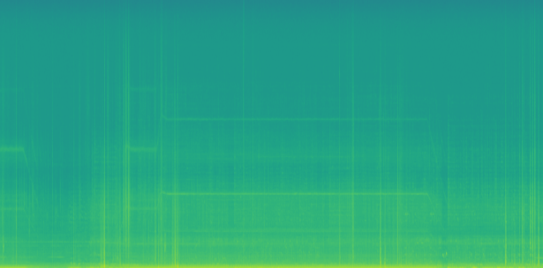


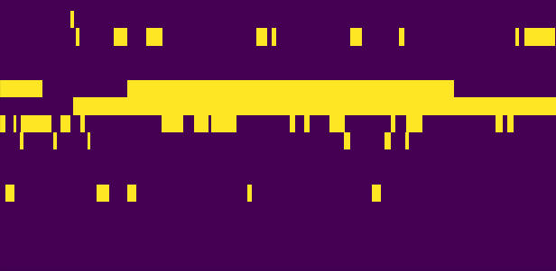
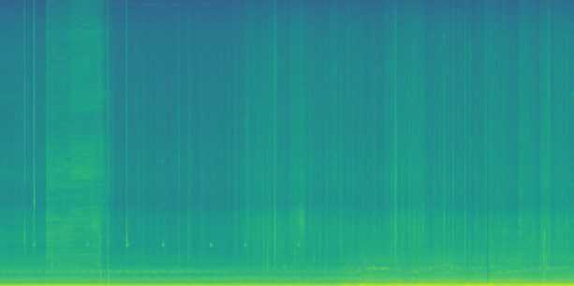
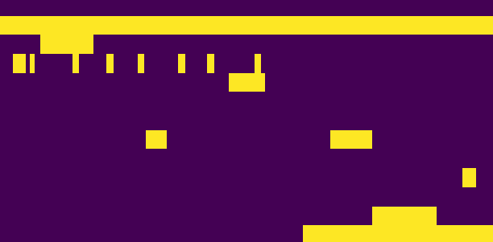
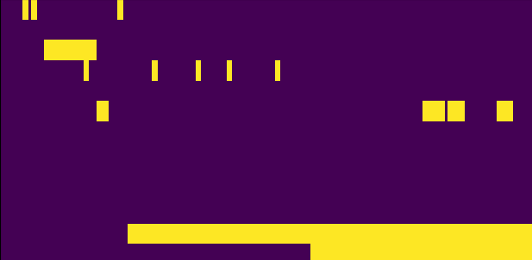
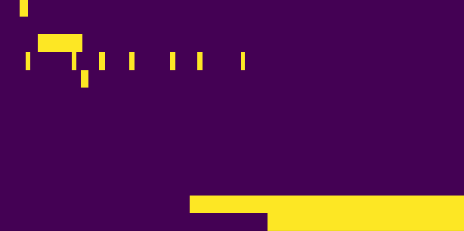
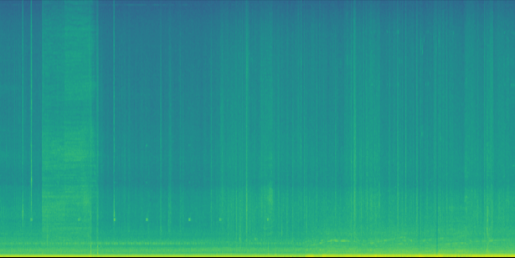


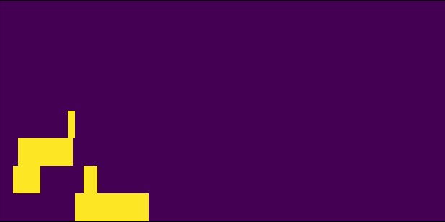
Building the LEAD dataset
Dataset for a better understanding of the variations in strong labels
The LEAD dataset provides distinct strong labels for each clip annotated by 20 different annotators.
Audio data
LEAD dataset
Annotator 1
Annotator 2
Annotator 20
...
...
...
Notes:
The LEAD dataset was built to gain a better understanding of the variations in strong labels. The LEAD dataset provides distinct strong labels for each clip annotated by 20 different annotators.

Slide 9
Data source
LEAD dataset has 20 strong labels for 5.67 hours of sound.
Sound from four previous datasets
Audio data
LEAD dataset
Annotator 1
TUT Sound Events (SE) 2016 [1] / 2017 [2]
...
TUT Acoustic Scenes (AS) 2016 [1]
...
URBAN-SED [3]
...
[1] A. Mesaros, et al., “TUT database for acoustic scene classification and sound event detection,” Proc. EUSIPCO, pp. 1128–1132, 2016.
[2] A. Mesaros, et al., “Challenge setup: Tasks, datasets and baseline system,” Proc. Workshop on DCASE, pp. 85–92, 2017.
[3] J. Salamon, et al., “Scaper: A library for soundscape synthesis and augmentation,” Proc. WASPAA, pp. 344–348, 2017.
Notes:
The LEAD dataset has 20 strong labels for 5.67 hours of sound which is from the four previous datasets, say, data source, TUT Sound Events 2016/2017, TUT Acoustic Scenes 2016, and URBAN-SED. The original URBAN-SED contains no variation among annotators because of its sound is synthesized. However, by assigning new strong labels to sound signals in URBAN-SED, the LEAD dataset enables us to compare the annotations for datasets with different characteristics.

Slide 10
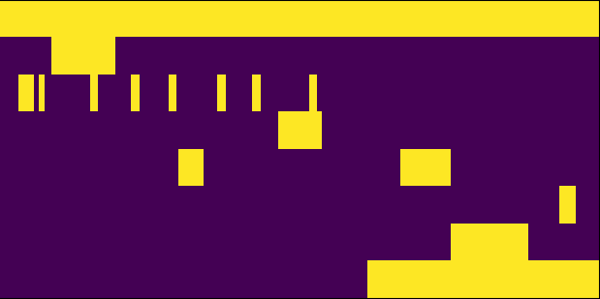
Annotation procedure
Assigning strong labels to sound signals
Assigning a confidence score (CS) to the selected class, onset, and offset for each sound event instance
The sound of bus
Annotator 1
bus
door
electronic_sound
object_clacking
object_rustling
people_breathing
people_walking
vehicle_engine
Frequency (Hz)
Time (s)
Time (s)
Notes:
The annotation of strong labels in the LEAD dataset consists of two procedures. The first procedure is assigning strong labels to sound signals included in data sources. The second procedure is assigning a confidence score to the selected class, onset, and offset for each sound event instance.

Slide 11

Assigning strong labels to sound signals
All annotators selected classes, onsets, and offsets from the candidates.
The sound of bus
Annotator 1
bus
door
electronic_sound
object_clacking
object_rustling
people_breathing
people_walking
vehicle_engine
Frequency (Hz)
Time (s)
Time (s)
Notes:
The first procedure is assigning strong labels to sound signals included in data sources. All annotators selected classes, onsets, and offsets from the candidates. As an example of the first procedure, please listen to the sound. As you hear, this is the sound of bus rides.

Slide 12
Assigning strong labels to sound signals
All annotators selected classes, onsets, and offsets from the candidates.
The sound of bus
Annotator 1
bus
door
electronic_sound
object_clacking
object_rustling
people_breathing
people_walking
vehicle_engine
Frequency (Hz)
Time (s)
Time (s)
Notes:
So, annotator 1 assigned the sound event “electronic_sound” to this sound signal.

Slide 13
Assigning confidence scores (CSs) to sound events
Assigning a CS to the selected class, onset, and offset for each sound event instance
A five-point scale ranging from “very unconfident” to “very confident”
The sound of bus
Annotator 1
bus
door
electronic_sound
object_clacking
object_rustling
people_breathing
people_walking
vehicle_engine
Frequency (Hz)
Time (s)
Time (s)
Notes:
The second procedure is assigning confidence scores to the selected class, onset, and offset for each sound event instance. We set the confidence score on a five-point scale ranging from “very unconfident” to “very confident”.

Slide 14
Assigning confidence scores (CSs) to sound events
Assigning a CS to the selected class, onset, and offset for each sound event instance
A five-point scale ranging from “very unconfident” to “very confident”
The sound of bus
Annotator 1
bus
door
electronic_sound
object_clacking
object_rustling
people_breathing
people_walking
vehicle_engine
Frequency (Hz)
CS (event class): “very unconfident”
CS (on/offset): “very confident”
Time (s)
Time (s)
CS: Confidence score
Notes:
Here, as an example of the second procedure, the confidence scores assigned to one of “electronic_sound” are “very unconfident” for sound event class and are “very confident” for onset and offset.

Slide 15
Overview of our contributions
Building the LEAD dataset
Analyses with the LEAD dataset
Experiment with the LEAD dataset
Notes:
Let’s move on to the next contribution, the analyses with the LEAD dataset.

Slide 16
Overview of the analyses with the LEAD dataset
Analysis 1: Categorizing the variations in strong labels manually
Analysis 2: Confirming a relationship between strong labels and CSs
Analysis 2-a: Objective analysis of CSs
Analysis 2-b: Subjective analysis of CSs
Notes:
We conducted three analyses. Analysis 1, Categorizing the variations in strong labels manually. Analysis 2, Confirming a relationship between strong labels and confidence scores, and this analysis is split into two analyses. One is the objective analysis, and the other is the subjective analysis.

Slide 17
Analysis 1: Categorizing the variations in strong labels
Purpose: To make the variations in strong labels distinguishable
Variations in sound event classes
Label deletion
Label substitution
Label insertion
Hierarchical label substitution
Label integration
Temporal variations in strong labels
Notes:
Analysis 1 is categorizing the variations in strong labels manually. The purpose of Analysis 1 is to make the variations in strong labels distinguishable. We categorized the variations into six categories, label deletion, label insertion, label integration, label substitution, hierarchical label substitution, and temporal variations.

Slide 18
Analysis 1: Categorizing the variations in strong labels
Purpose: To make the variations in strong labels distinguishable
Variations in sound event classes
Label deletion
Label substitution
Label insertion
Hierarchical label substitution
Label integration
Temporal variations in strong labels
Notes:
As an example, today I will introduce “label deletion.”

Slide 19
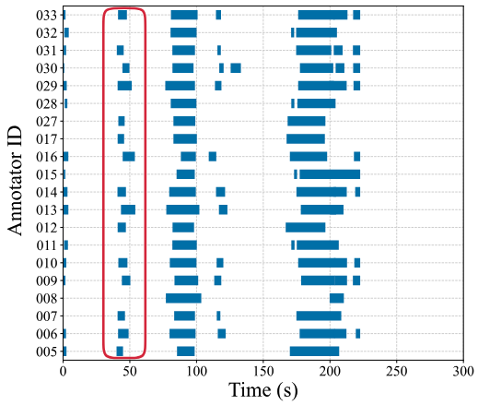
Label deletion
An event label which is not assigned to an expected sound event
e.g., “bird_singing” in b006.wav
Notes:
Label deletion represents “an event label is not assigned to an expected sound event.“
As an example, the red square in the figure shows the label deletion.
各ラベルのばらつきの定義を置いとく
label insertion
label integration
label substitution
hierarchical label substitution
temporal variation

Slide 20
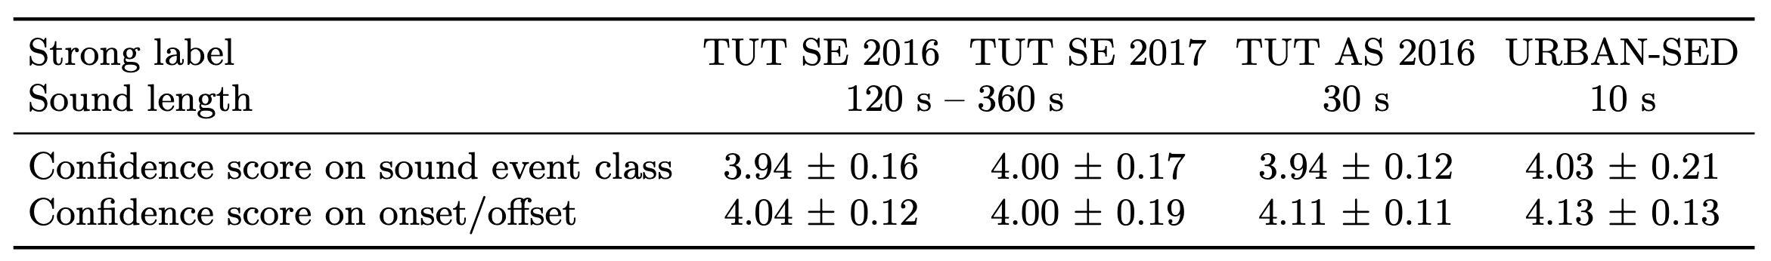
Analysis 2-a: Objective analysis of CSs
Investigating the differences of average CSs between real-world and synthetic sounds
No significant difference can be seen between the average CSs of URBAN-SED and other datasets.
Notes:
Analysis 2-a is investigating the differences of average CSs between real-world and synthetic sounds. We calculated average confidence scores with 95% confidence intervals. The table shows data source, sound length, and average confidence scores. Focus on the result of URBAN-SED, no significant difference can be seen b/w URBAN-SED and other datasets even though the annotators can more easily assign strong labels than in the case of using other datasets.

Slide 21
Analysis 2-b: Subjective analysis of temporal CSs
Visualizing the relationship between CSs and 20 strong labels
Temporally shorter sound events with high CS were more likely to vary over time.
Very confident
Confident
Neutral
Unconfident
Very unconfident
Notes:
Analysis 2-b is visualizing the relationship between CSs and 20 strong labels.
I investigated whether the agreement among annotators correlates with confidence scores.
In this figure, I illustrated 20 different strong labels of some classes assigned to one sound signal with confidence scores.
Temporally shorter sound events with high confidence scores were more likely to vary over time as I highlighted in the figure.

Slide 22
Overview of our contributions
Building the LEAD dataset
Analyses with the LEAD dataset
Experiment with the LEAD dataset
Notes:
Let’s move on to the last contribution, the experiment with the LEAD dataset.

Slide 23
Overview of the experiment
Pseudo-detection performance with strong labels
Purpose: To Investigate the influence of the variations in strong labels on the detection performance in SED
We calculated a pseudo-detection performance for each data source of the LEAD dataset.
Notes:
As an experiment, We calculated a pseudo-detection performance with strong labels in the LEAD dataset.
The purpose of this experiment is to investigate the influence of the variations in strong labels on the detection performance. We calculated a pseudo-detection performance for each data source of the LEAD dataset.

Slide 24
How to calculate the pseudo-metrics
Picking up one annotator’s strong label as the ground truth
Calculating the metrics of the sound signals in each data source of the LEAD dataset
Ground truth
Predicted labels
Notes:
To calculate the pseudo-detection performance with 20 strong labels,
We picked up one annotator’s strong label as the ground truth, and the remaining 19 labels were used as the predicted labels.
Here, I will show an example of how to calculate pseudo-metrics.
First, the strong label assigned by the top annotator is selected as the ground truth.

Slide 25
How to calculate the pseudo-metrics
Picking up one annotator’s strong label as the ground truth
Calculating the metrics of the sound signals in each data source of the LEAD dataset
Ground truth
Predicted labels
Notes:
Then, the strong label assigned by the second annotator is selected as the ground truth.

Slide 26
How to calculate the pseudo-metrics
Picking up one annotator’s strong label as the ground truth
Calculating the metrics of the sound signals in each data source of the LEAD dataset
Ground truth
Predicted labels
Notes:
Finally, the strong label assigned by the bottom annotator is selected as the ground truth.
Like this example, we calculated 380 pseudo-detection performances from strong labels assigned to one sound signal.

Slide 27
Conditions of metrics
Segment-based micro-F-score [1]
Event-based micro-F-score [1]
Intersection-based micro-F-score [2]
[1] A. Mesaros, et al., “Metrics for polyphonic sound event detection,” Applied Sciences, vol. 6, no. 6, p. 1–17, 2016.
[2] C. Bilen, et al., “A framework for the robust evaluation of sound event detection,” Proc. ICASSP, pp. 61–65, 2020.
Notes:
We conducted the experiments w/ three metrics.
Today I will show the results of two specific ones.

Slide 28
Conditions of metrics
Event-based micro-F-score [1]
Collar: 0.20 seconds
Predicted labels
Ground truth
Start
End
Time
Collar
Collar
[1] A. Mesaros, et al., “Metrics for polyphonic sound event detection,” Applied Sciences, vol. 6, no. 6, p. 1–17, 2016.
[2] C. Bilen, et al., “A framework for the robust evaluation of sound event detection,” Proc. ICASSP, pp. 61–65, 2020.
Notes:
One is an event-based micro-F-score, which compares predicted labels and ground truth for each event.
The collar setting is 0.2 seconds.

Slide 29
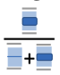
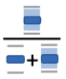
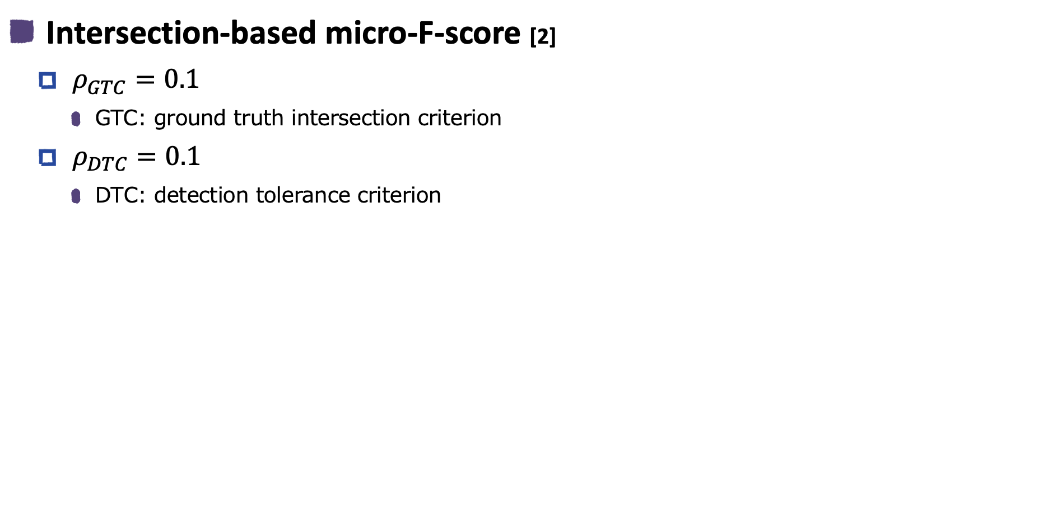
Conditions of metrics
Intersection-based micro-F-score [2]
$ρ_{GTC}=0.1$
GTC: ground truth intersection criterion
$ρ_{DTC}=0.1$
DTC: detection tolerance criterion
Ground truth intersection criteria
Predicted labels
Ground truth
Detection tolerance criteria
[1] A. Mesaros, et al., “Metrics for polyphonic sound event detection,” Applied Sciences, vol. 6, no. 6, p. 1–17, 2016.
[2] C. Bilen, et al., “A framework for the robust evaluation of sound event detection,” Proc. ICASSP, pp. 61–65, 2020.
Notes:
The other is an intersection-based micro-F-score, which uses intersection criteria rather than boundaries.
ローGTC is 0.1, andローDTC is also 0.1.
ローGTC: the threshold for the section of all predicted events intersecting with the ground truth
ローDTC: the threshold for the section of all ground truth intersecting with the predicted events

Slide 30
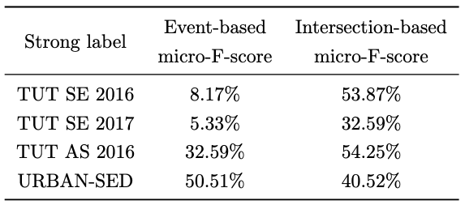
Pseudo-detection performance
Event-based micro-F-score got lower performance than the intersection-based micro-F-score.
Lower
Notes:
Here is the result of the experiment.
You can see that the event-based micro-F-score got a lower detection performance than the intersection-based micro-F-score.
Therefore, we conducted an additional experiment about event-based micro-F-score based on this result of the experiment.

Slide 31
Additional experiment
Influence of the collar setting on the detection performance
We checked the detection performance with various collar settings of the event-based micro-F-score using “water” in one sound signal.
The collars setting: intervals of 0.1 seconds from 0.0 to 5.0 seconds
Notes:
The purpose of an additional experiment is to investigate the influence of the collar setting on the detection performance.
We checked the detection performance with various collar settings of the event-based micro-F-score using “water” in one sound signal.
The collar setting is at intervals of 0.1 seconds from 0.0 to 5.0 seconds.

Slide 32
Event-based micro-F-score
Event-based micro-F-score rapidly increased up to 1.0 seconds.
Collar setting should be adjusted depending on the training data.
Notes:
Here is the result of an additional experiment.
The figure shows the event-based micro-F-score rapidly increased up to 1.0 seconds.
We found the collar setting should be adjusted depending on the training data.

Slide 33
Conclusion
Purpose of our study
To gain a better understanding of the variations in strong labels
Contributions
Building a large-scale dataset including the variations
Analyses: Classification of the variations in strong labels
Experiment: The temporal variations in sound events affect the detection performance.
Future work
Development a robust model against the variations in strong labels with the LEAD dataset
Notes:
Then I summarize my talk.
We released the LEAD dataset, which allows us to analyze how strong labels vary among annotators.
The purpose of our study is to gain a better understanding of the variations in strong labels.
We conducted the analysis and experiment of the variations in strong labels.
By the analysis of varying strong labels, we classified the variations in strong labels.
From the result of the experiment, we confirmed the temporal variations in sound events affect the detection performance.
Our future work is to develop a robust model against the variations with the LEAD dataset.

